Slide 1
Agile and Scrum Fundamentals

Slide 2

Before we get started
Be INTERACTIVE! Videos On Please :) Respond to questions, Ask Questions, Participate
Be FOCUSSED! DON'T multitask on emails, chats, other work. We all have important deliverables.
Will I cover everything you need to know? - NO
Learn by doing: Less about theory, more about practice
Frequent retrospectives are where the real learning happens
I am just a facilitator to help you figure it out
Have Fun !!!

Slide 3
Agenda
Introduction to Agile
Agile Values
Agile Principles
How to BE Agile
Agile vs. Waterfall Delivery
Different frameworks, practices under Agile
Five Dimensions of Team Capability
==================================
Mindset shifts for leadership
Managers role in an Agile Organisation

Slide 4
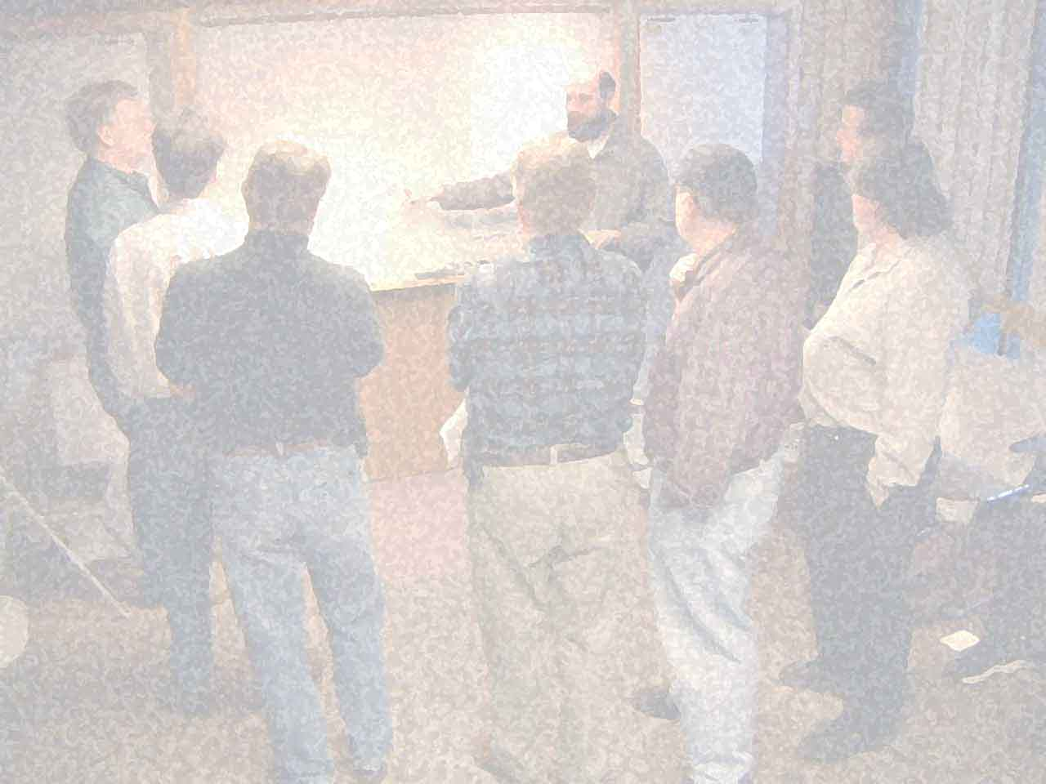
Confusion around Agile?
Why Agile?
What is Agile?
What are the benefits of Agile?
How do we prove or measure success of being agile?

Slide 5
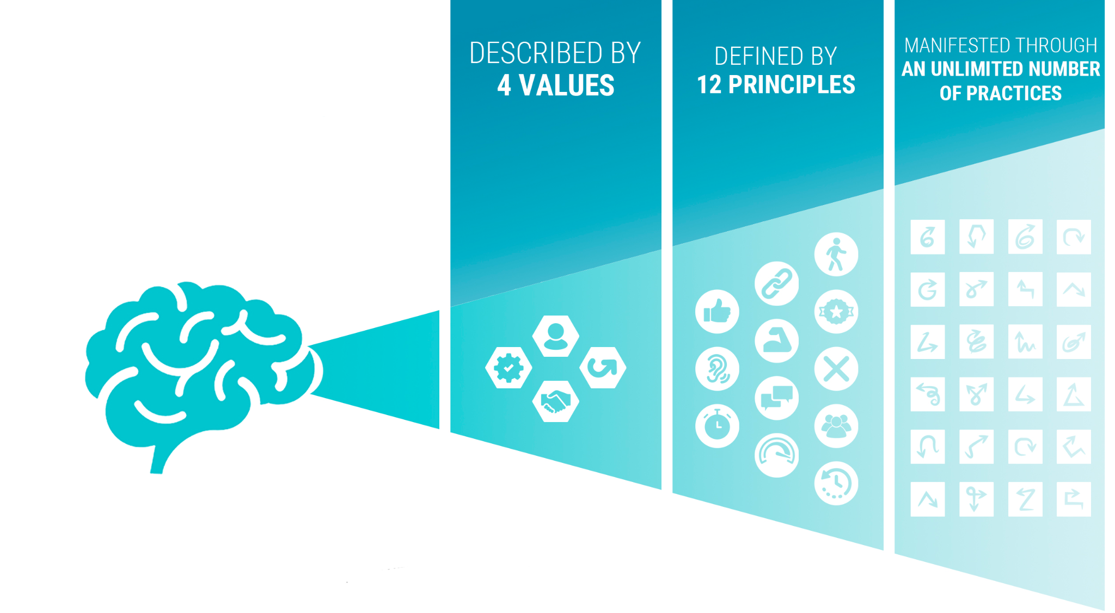
What is Agile?
Doing Agile
Being Agile

Slide 6
Manifesto for Agile Software Development - Agile Values
We are uncovering better ways of developing software by doing it and helping others do it.
Through this work we have come to value:
Individuals and interactions over processes and tools
Working software over comprehensive documentation
Customer collaboration over contract negotiation
Responding to change over following a plan
That is, while there is value in the items on the right, we value the items on the left more.
Kent Beck
Mike Beedle
Arie van Bennekum
Alistair Cockburn
Ward Cunningham
Martin Fowler
James Grenning
Jim Highsmith
Andrew Hunt
Ron Jeffries
Jon Kern
Brian Marick
Robert C. Martin
Steve Mellor
Ken Schwaber
Jeff Sutherland
Dave Thomas
© 2001, the above authors
this declaration may be freely copied in any form, but only in its entirety through this notice.

Slide 7
Principles behind the Agile Manifesto
Our highest priority is to satisfy the customer through early and continuous delivery of valuable software.
Welcome changing requirements, even late in development. Agile processes harness change for the customer's competitive advantage.
Deliver working software frequently, from a couple of weeks to a couple of months, with a preference to the shorter timescale.
Business people and developers must work together daily throughout the project.
Build projects around motivated individuals. Give them the environment and support they need, and trust them to get the job done.
The most efficient and effective method of conveying information to and within a development team is face-to-face conversation.
Working software is the primary measure of progress.
Agile processes promote sustainable development. The sponsors, developers, and users should be able to maintain a constant pace indefinitely.
Continuous attention to technical excellence and good design enhances agility.
Simplicity--the art of maximizing the amount of work not done--is essential.
The best architectures, requirements, and designs emerge from self-organizing teams.
At regular intervals, the team reflects on how to become more effective, then tunes and adjusts its behavior accordingly.

Slide 8
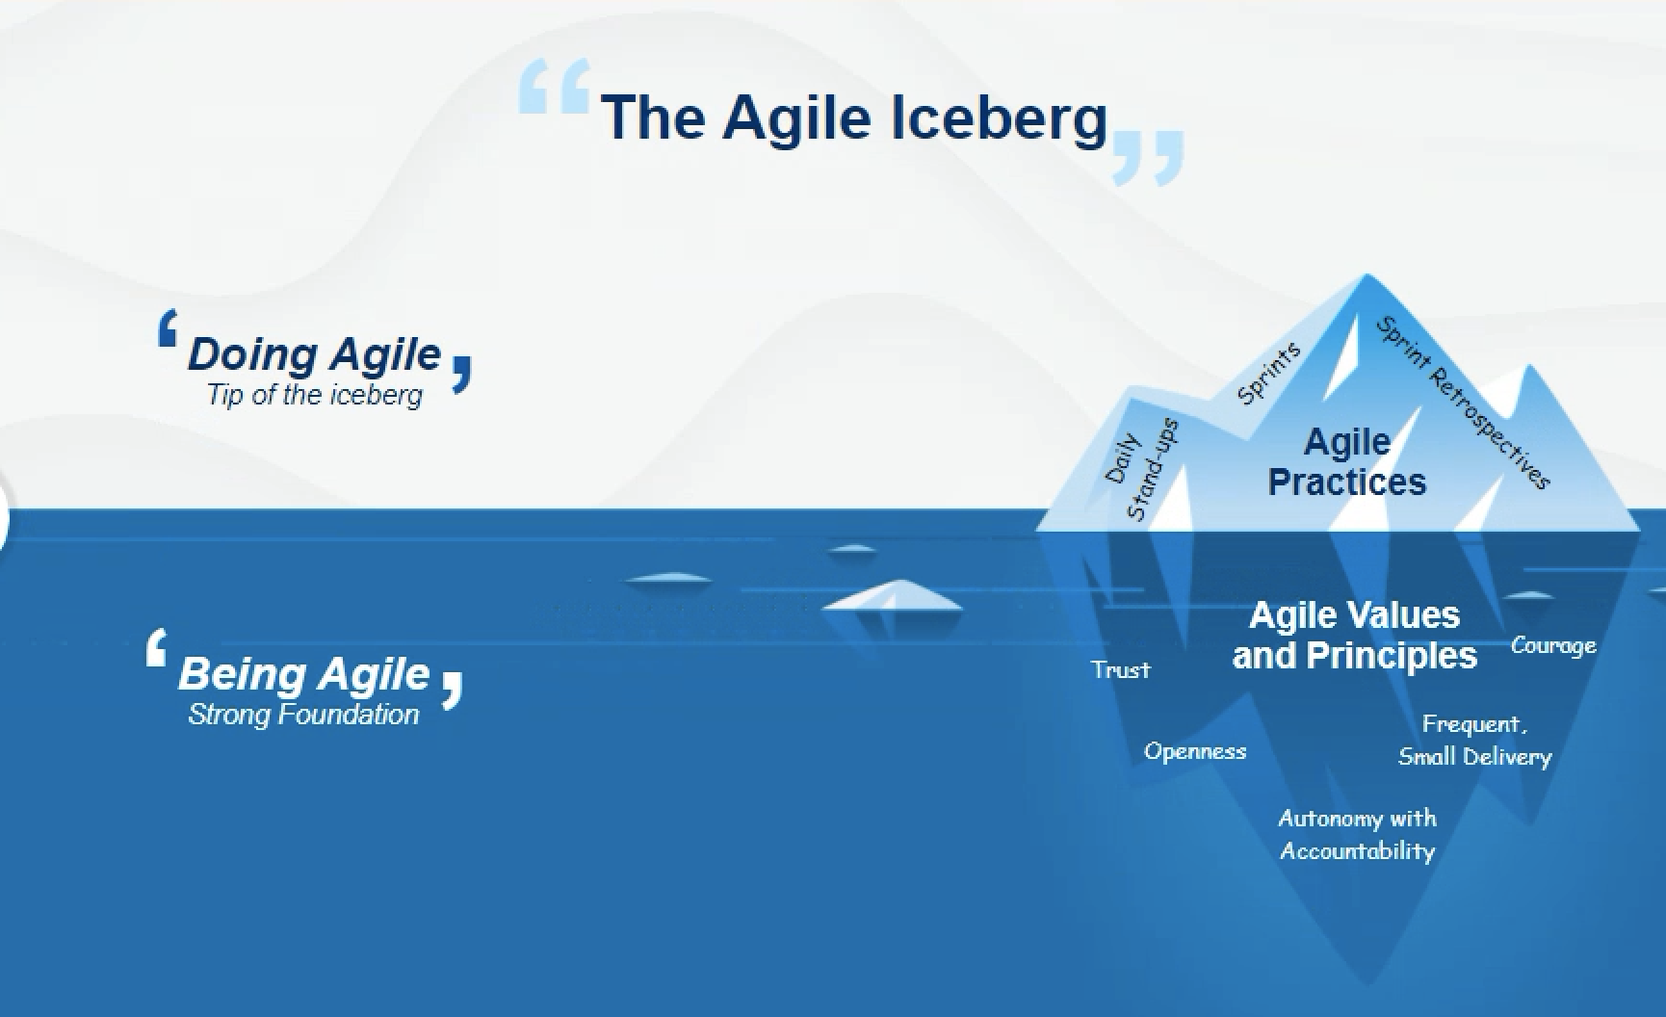
Agile Iceberg - Doing vs Being Agile

Slide 9
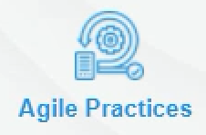
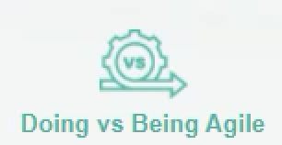
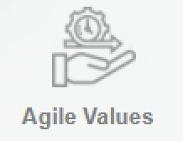
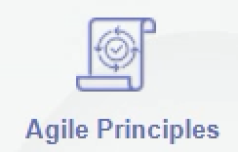
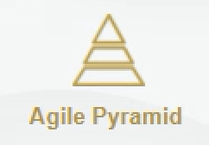





So far what’s covered..

Slide 10
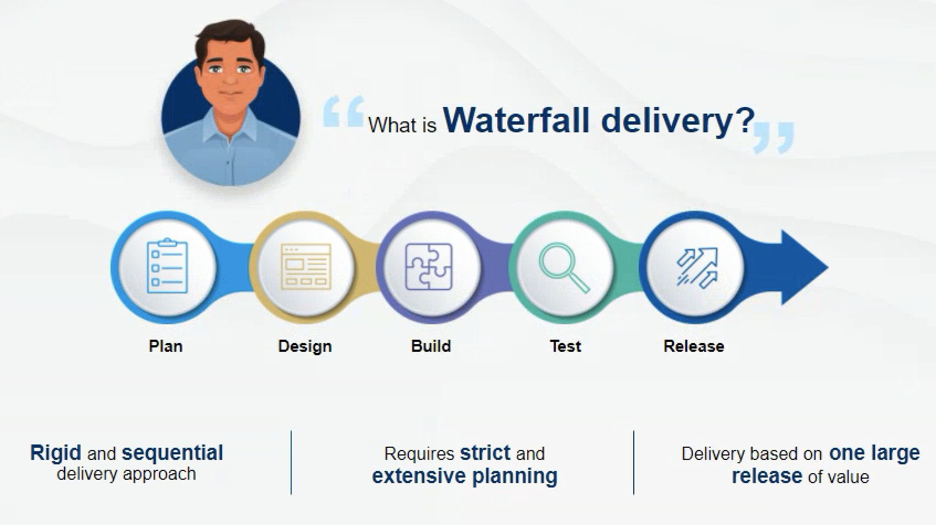
What is Waterfall?

Slide 11
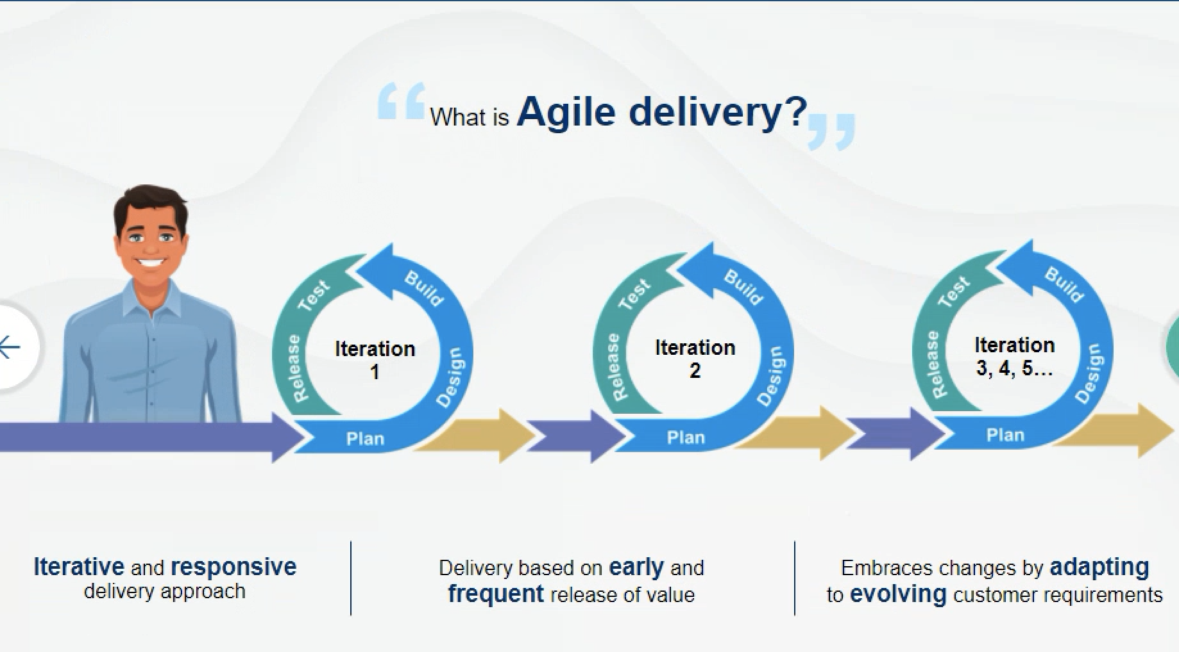
What is Agile delivery ?

Slide 12
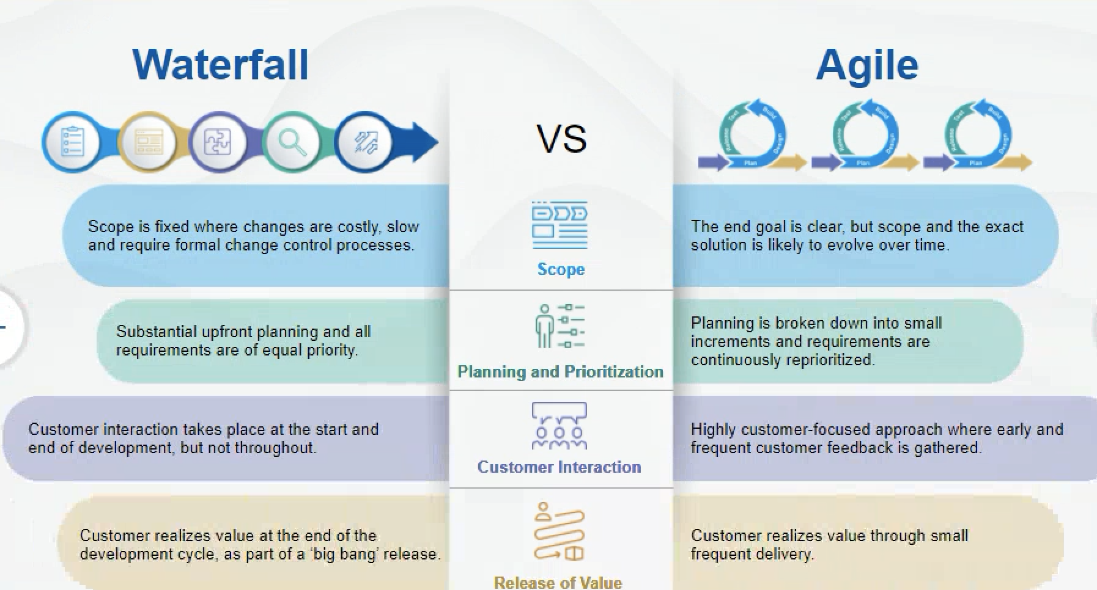
Difference between Waterfall and Agile

Slide 13
Advantages of Agile Delivery
Speed to Market
Adaptability
Business and customer Value
Reduced Delivery Risk
Visibility
Increased team morale
Improved engineering discipline
Improved Quality and many more…

Slide 14
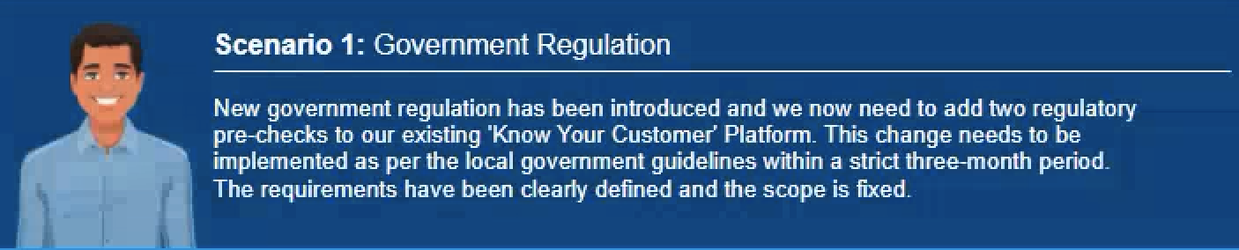
Which approach to adopt?

Slide 15
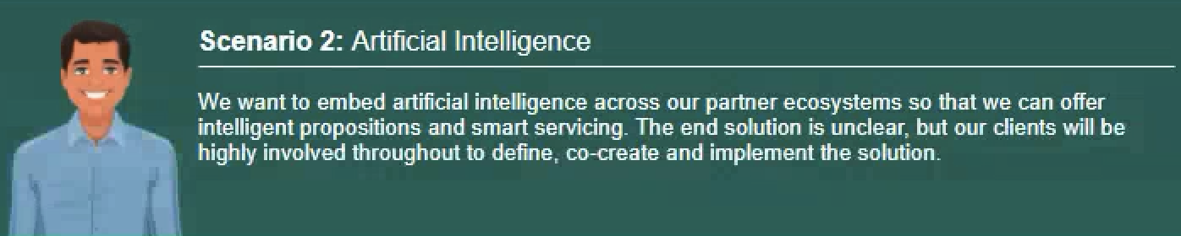
Which approach to adopt?

Slide 16
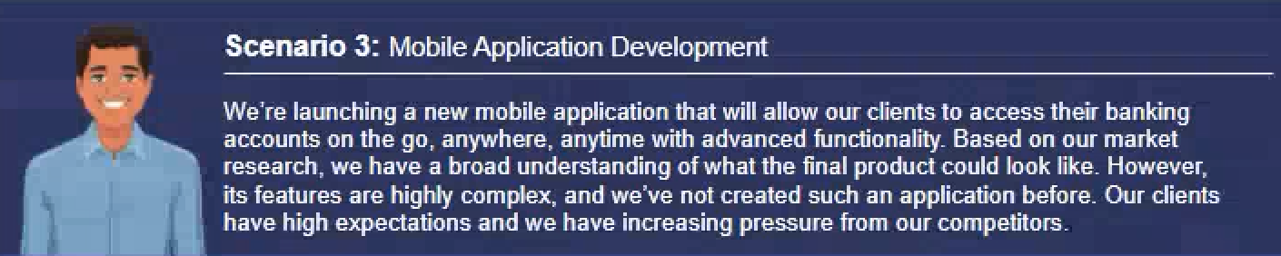
Which approach to adopt?

Slide 17
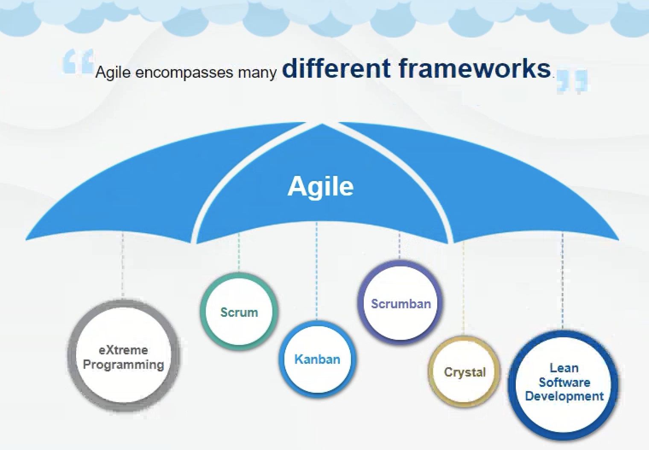
Different Frameworks under Agile

Slide 18
Questions ?
Feel free to reach a.tiwari@kokonetworks.com for more information

